Slide 1

Green Pace
Security Policy Presentation
Developer: Jamie Javis
[Complete this template by replacing the bracketed text with the relevant information.]

Slide 2

OVERVIEW: DEFENSE IN DEPTH
Below is a model of cyber security and the defense in depth as an illustration.

Slide 3
THREATS MATRIX
Priority and levels show the likelihood and severity of threats.
Likely High severity of attacks to happen | Priority More priorities have higher risk levels
Low priority Expensive repair, but low exploitability | Unlikely Low severity of attack to happen

Slide 4
10 PRINCIPLES
Input Validation
Heed Compiler Warnings
Architect and Design for Security Policies Keep it Simple
Default Deny
Adhere to the Principle of Least Privilege
Sanitize Data Sent to Other Systems
Practice Defenses in Depth
Use Effective Quality Assurance Techniques
Adopt a Secure Coding Standard

Slide 5
CODING STANDARDS
Data Type
Data Value
String Correctness
SQL Injection
Memory Protection
Assertions
Exceptions
Naming Conventions
Code Modularity
Resource Management

Slide 6
ENCRYPTION POLICIES
Encryption at rest safeguards stored data.
Encryption in transit protects data as it moves between devices, whether within a network or across external connections.
Encryption in use protects data while it is created, edited, or actively processed.

Slide 7
TRIPLE-A POLICIES
Authentication is the process of verifying a person's identity.
Authorization defines a user's access rights and privileges
Accounting involves tracking activities within a system, logging details such as timestamps, accessed resources, and data transfer information.

Slide 8
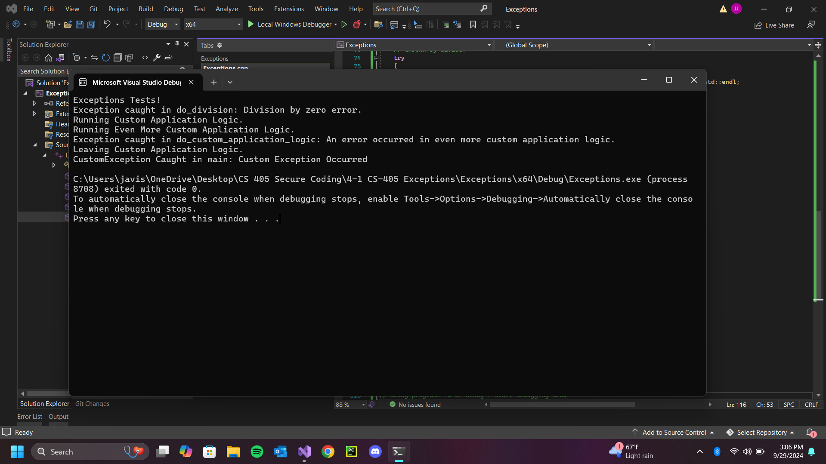
Unit Testing
Exceptions – Depending on the type of exception caught, specific messages are printed to the console to validate proper handling of different exceptions and to provide error information from the console for debugging purposes.

Slide 9
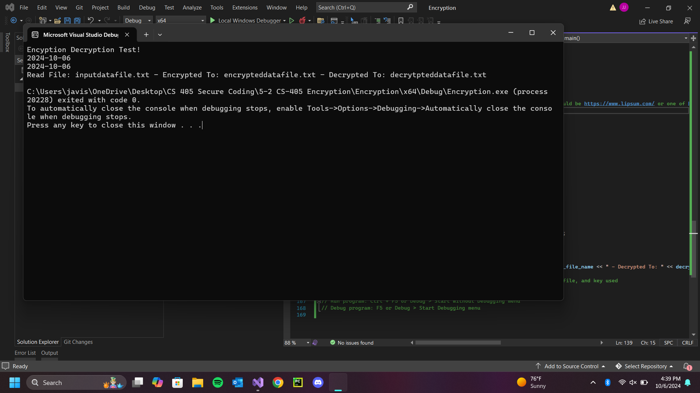
Unit Testing
Encryption – In the save_data_file function, it included functionality to write the name, the current date, and the password/key, and then move the encrypted/decrypted data to the specified file.

Slide 10
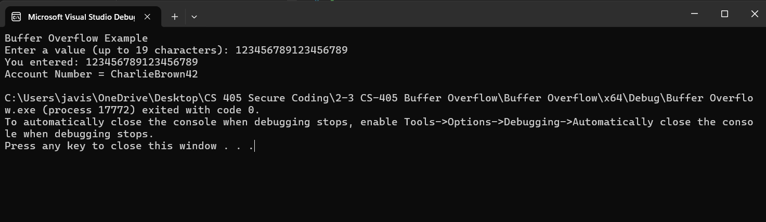
Unit Testing
Buffer Overflow (Pass) - If the input met the maximum input, the message displayed would show the account number.

Slide 11
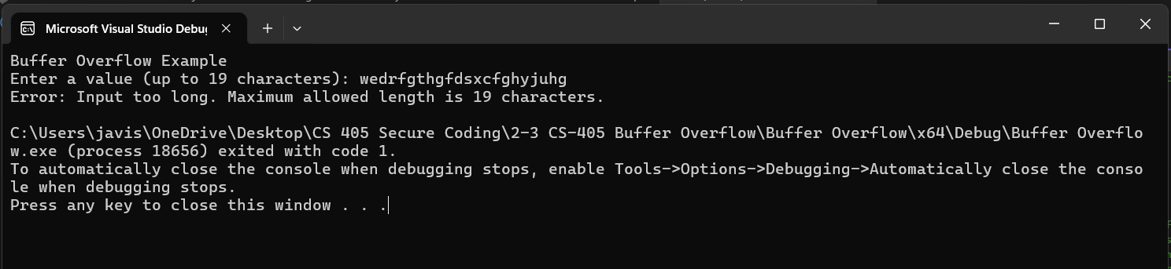
Unit Testing
Buffer Overflow (Fail) - If the user input was more than the characters allowed entered, an error message would display

Slide 12

AUTOMATION SUMMARY

Slide 13
TOOLS
The DevSecOps pipeline integrates development, security, and operations into a cohesive process that ensures security is embedded throughout the software development lifecycle (SDLC).
Automated Testing Frameworks: Tools such as Selenium or JUnit can integrate security tests into CI/CD pipelines.

Slide 14
RISKS AND BENEFITS
Often, security is treated as an afterthought, leading to vulnerabilities being discovered late in the development process. Adopt a shift-left approach by incorporating security practices from the planning and development phases.
Development and operations teams may lack adequate security training or awareness, resulting in insecure coding practices. Provide regular training and resources for development and operations teams on secure coding practices and threat modeling.
Security policies may not be uniformly applied across all stages of the pipeline, leading to gaps in security. Develop and enforce consistent security policies and practices across the entire DevSecOps pipeline.

Slide 15
RECOMMENDATIONS
Policies may not mandate regular risk assessments to identify and evaluate new threats and vulnerabilities.
Failure to incorporate threat modeling processes during project planning can lead to overlooking potential attack vectors.
Policies may not require regular training for employees on security best practices, social engineering awareness, or compliance regulations.

Slide 16
CONCLUSIONS
GDPR (General Data Protection Regulation) - A regulation in the EU that sets guidelines for the collection and processing of personal information. Compliance ensures that organizations protect personal data and privacy.
ITIL (Information Technology Infrastructure Library) - A set of practices for IT service management (ITSM) that focuses on aligning IT services with business needs. ITIL includes practices for incident management, change management, and service continuity.

Slide 17
REFERENCES
Apps, S. C. (2022, December 22). Defense in Depth: Definition, Layers, Benefits & More. Spanning. https://spanning.com/blog/defense-in-depth/
Center for Internet Security. (2024). Cybersecurity Spotlight - Defense in Depth (DiD). CIS. https://www.cisecurity.org/insights/spotlight/cybersecurity-spotlight-defense-in-depth-did
Defense-in-Depth: A Comprehensive Approach to Modern Cybersecurity - MixMode. (n.d.). Https://Mixmode.ai/. https://mixmode.ai/blog/defense-in-depth-a-comprehensive-approach-to-modern-cybersecurity/
Forcepoint. (2019, January 24). What is Defense in Depth? Forcepoint. https://www.forcepoint.com/cyber-edu/defense-depth
Ryther, J. (2022, February 6). Don’t Leave Security to the End - Josh Ryther - Medium. Medium; Medium. https://medium.com/@jryther91/dont-leave-security-to-the-end-ca13b107d4

